Slide 1
Fourier Transform
Fourier Transform (FT) is the equivalent of Fourier Series (FS) but it applies to continuous time signal which are non-periodic or aperiodic.
Fundamental difference is that the FT leads to a spectrum which is continuous in frequency but the FS leads to a spectrum which is discrete in frequency.
Continuous frequency implies that every single frequency component is present. Hence the spectrum is a continuous graph with frequency as the x-axis.
Discrete frequency implies that only some frequencies are present. Hence the spectrum is a set of discrete lines at the frequencies where the components have non-zero amplitudes. See slides 2-13 and 2-14.

Slide 2
Let be an aperiodic signal with a spectrum or frequency domain model denoted by or where f and ω represents frequencies in Hz and rad/s respectively.
The Fourier Transform is defined by :
To reconstruct the signal from or , the inverse FT is applied :
Notation : We use small cap to denote the time signal ie x(t) while big caps are used to denote its corresponding Fourier Transform ie X(f)
FT pair

Slide 3
Example 2-2 : Determine the spectrum of the rectangular pulse,
A
0
→ t
is given by
The Fourier transform of
Fourier Transform pair

Slide 4
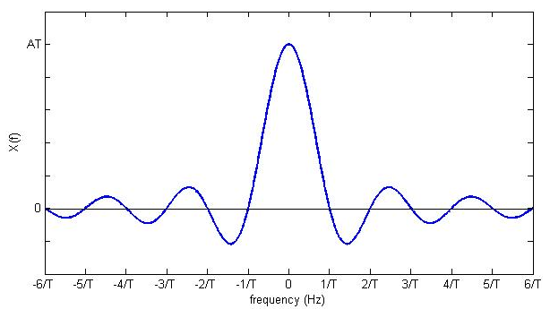
Plot of X(f) against continuous frequency f
X(f) which is the FT of x(t) is also the spectrum of x(t).
The spectrum shows that x(t) contains all frequencies with amplitudes which are diminishing as frequency gets larger.

Slide 5
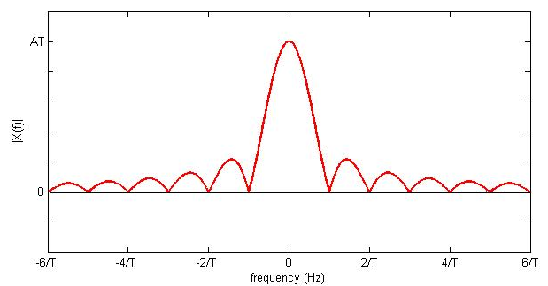
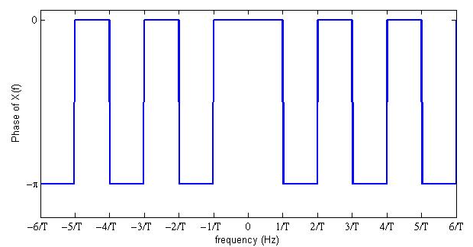
Amplitude Spectrum of x(t)
Phase Spectrum of x(t)

Slide 6
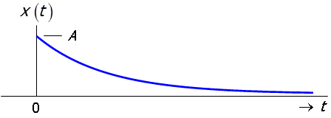
Example 2-3 : Determine the spectrum of an exponentially decaying pulse,
u(t) is a unit step function defined in slide 1-11
The FT of x(t) is given by :

Slide 7
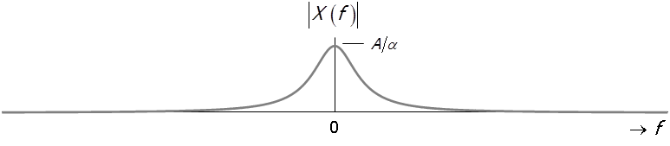
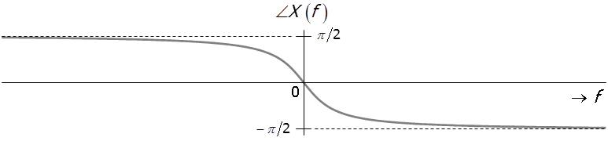
X(f) is no longer a real function of frequency f but instead is a complex function,
Amplitude Spectrum:
Phase Spectrum:
Since X(f) is complex, the magnitude and phase spectra cannot be combined into a single spectrum.

Slide 8
Summary
Signals can be viewed in two domains : time and frequency domains
Fourier Series (FS) is a mathematical tool used to decompose a periodic signal into its frequency components
Fourier Transform (FT)is an equivalent tool which is applicable to aperiodic signal. It decomposes aperiodic signal into its frequency components.
FS leads to a signal spectrum with discrete frequencies
FT leads to a signal spectrum with continuous frequencies
The properties of FT (next lecture) are important as they help us deal with different type of signals which occur in many signal processing applications.

Slide 9
Properties of the Fourier Transform
Let
Property 1 (Linearity)

Slide 10
Example 3-1 : Consider x(t) given by :
8
3
-2.5
-1
0
1
2.5
x(t) may be modeled as
Applying the LINEARITY property:
Recall :

Slide 11
Property 2 (Scaling)
Example 3-2 : Consider the FT pair :
The scaling property of the FT tells us that :
A
A
0
→ t
0
→ t

Slide 12
→ t
→ f
-1
-0.5
0
0.5
1
-3
-2
-1
0
1
2
3
→ t
→ f
-1
-0.5
0
0.5
1
-3
-2
-1
0
1
2
3
→ t
→ f
-1
-0.5
0
0.5
1
-3
-2
-1
0
1
2
3
Wide pulses are called narrowband (in terms of frequencies) pulses.
Narrow pulses are called wideband (in terms of frequencies) pulses.

Slide 13
Property 3 (Duality)
Example 3-3 : Consider the sinc function :
where α and B are positive constants
Starting with the FT pair :
Duality Property
Substitute and , we get

Slide 14
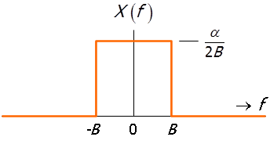
Applying the duality property :
Hence

Slide 15
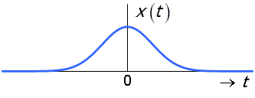
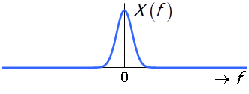
Property 4 (Time Shifting)
Example 3-4 : Let x(t) be a normalized Gaussian pulse with FT pair :
Applying the time shifting property :

Slide 16
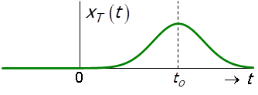
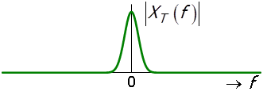
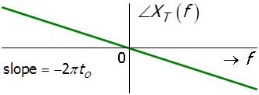
Time shifting

Slide 17
Property 5 (Frequency Shifting)
Example 3-5 : Let x(t) be a normalized Gaussian pulse with FT pair :
Applying the frequency shifting property :

Slide 18
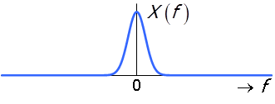
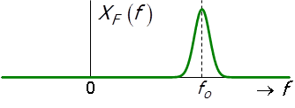
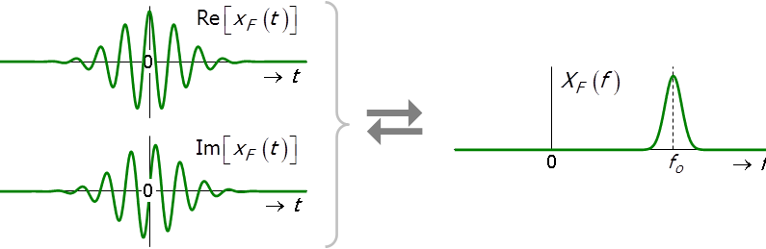
Frequency shifting

Slide 19
Property 6 (Differentiation in Time Domain)
Example 3-6 : Let x(t) be a normalized Gaussian pulse.

Slide 20
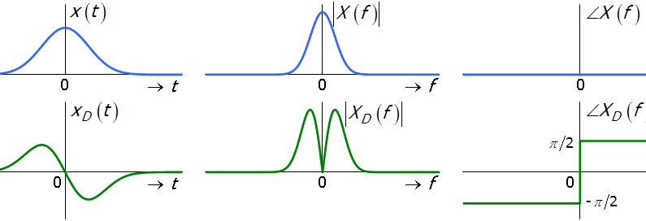

Slide 21
Property 7 (Integration in Time Domain)
where is the average value of x(t).
If X(0)= 0, then

Slide 22
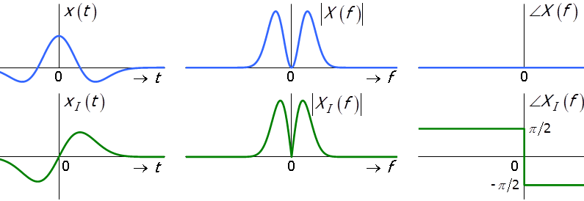
Example 3-7 : Let x(t) be the 2nd derivative of an inverted normalized Gaussian pulse :

Slide 23
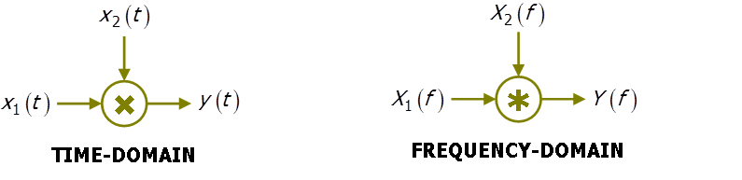
Property 8 (Multiplication in Time Domain)
Example 3-8 : Multiplication of 2 signals often found in multiplier or mixer circuits
These are Fourier Transform pairs

Slide 24
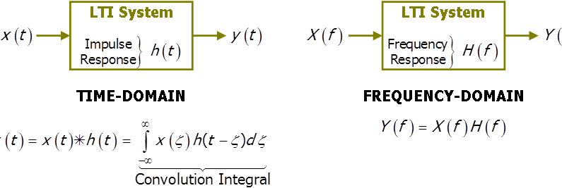
Property 9 (Convolution in Time Domain)
Example 3-9 : Useful for studying certain classes of systems (linear time invariant (LTI) systems)
Fourier Transform pairs

Slide 25
To demonstrate the significance of convolution
Consider the convolution of two time domain functions :
1
0
1
0
1

Slide 26
1
1
0
0
1
1
1
-1
0
-1+t
t
0
Illustration of f₂(t-τ) for values of t =-2 and t =2 :
1
1
-3
-2
0
0
1
2

Slide 27
Demonstration of convolution
1
-1+t
t
0
1
-1.5
-0.5
1
1

Slide 28
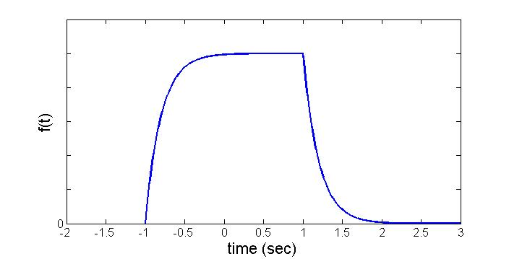
1
1
Final convolution :
Convolution is tedious in time domain but can be dealt with easily in frequency domain. Will see this in the 2nd half of sem.

Slide 29
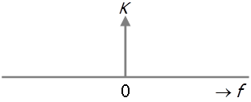
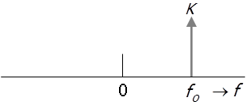
Fourier Transforms of Commonly Encountered Signals
Signal 1 : DC Signal
Signal 2 : Exponential Signal

Slide 30
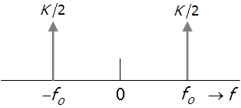
Signal 3 : Cosine Signal

Slide 31
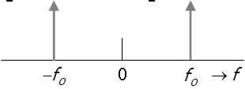
Signal 4 : Sine Signal

Slide 32
Signal 5 : Arbitrary Periodic Signal
Fourier Series :
Applying Fourier transform to
Substituting gives

Slide 33
The Fourier Transform of an arbitrary periodic signal is given by
where c_{k} are coefficients obtained from the Fourier Series.
The frequency components are discrete at frequencies kf_{p} Hz and extends over all frequencies, positive and negative.
For the periodic square wave function from lecture 2 :

Slide 34
Example 3-10 :
1
Periodic
Signal
. . . . . . . . . .
. . . . . . . . . .
-3
-2.5
-2
-1.5
-1
-0.5
0
0.5
1
1.5
2
2.5
→ t
Discrete
-frequency
Spectrum
Continuous
-frequency
Spectrum
-15
-13
-11
-9
-7
-5
-3
-1
0
1
3
5
7
9
11
13
→
15
-7.5
-6.5
-5.5
-4.5
-3.5
-2.5
-1.5
-0.5
0
0.5
1.5
2.5
3.5
4.5
5.5
6.5
7.5
→

Slide 35


Example 3-11 : Spectrum of a Comb function
Fourier coefficients :

Slide 36

Fourier Transform :
Note how the amplitude component has changed to 1/T.

Slide 37
Summary
Signals can be viewed in two domains : time and frequency domains
Fourier Series (FS) is a mathematical tool used to decompose a periodic signal into its frequency components
Fourier Transform (FT)is an equivalent tool which is applicable to aperiodic signal. It decomposes aperiodic signal into its frequency components.
FS leads to a signal spectrum with discrete frequencies
FT leads to a signal spectrum with continuous frequencies
The properties of FT are important as they help us deal with different type of signals which occur in many signal processing applications.

